Slide 1
Stretford Grammar School
Candidate Exam Briefing

Slide 2
Purpose of this Presentation
To inform candidates about the use of their personal data and copyright
To ensure candidates are provided with all relevant information about their exams in advance of any exams being taken
To ensure copies of relevant JCQ information for candidates documents and exam room posters are provided in advance of any exams/assessments being taken
To inform candidates about malpractice in examinations/assessments
To answer questions candidates may have
To inform candidates of/signpost candidates to any exams-related policies/procedures that they need to be made aware of

Slide 3
Personal Data & Copyright
To understand what information is collected and how it is used, you must read the JCQ Information for candidates - Privacy Notice (Available on the Website)
The copyright of any work created by a candidate that is submitted to an awarding body for assessment (referred to as Assessment Materials) belongs to the candidate
By submitting this work, a candidate is granting the awarding body a non-exclusive, royalty-free licence to use their assessment materials (referred to as Assessment Licence)
If a candidate wishes to terminate the awarding body’s rights for anything other than assessing his/her work, the awarding body must be notified by the centre and it is at the discretion of the awarding body whether or not to terminate such rights

Slide 4
Individual Candidate Timetable
A copy was given out in February, followed by another one in April.
Take a photo of it on your phone, and add the dates in to your electronic calendar

Slide 5
Equipment
You should have a clear plastic wallet with all the stationery for your Exams.
It should contain:
BLACK pen x2 (the only colour accepted by the exam boards)
Pencil x2
Eraser
Protractor
Ruler
Calculator (if allowed)
Highlighters – for your use on the Question Paper (i.e. highlighting won’t be marked)
Pencil Sharpener
Pair of compasses

Slide 6

No watches are allowed in the examination room.
If you are found to be in possession of an unauthorised device during your exam, whether switched on or off, you are committing Malpractice and could result in you being disqualified.
All unauthorised materials should be handed in before you enter the Exam Room

Slide 7
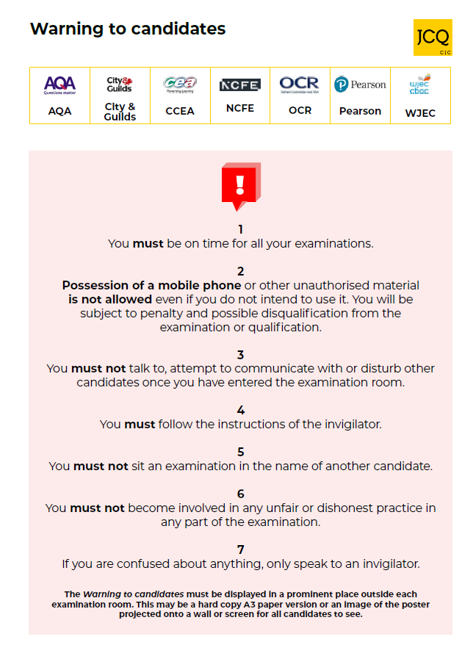
This poster will be displayed outside your exam room
You MUST note all the warnings

Slide 8
JCQ Information for Candidates
Written Examinations & Social Media
  These documents have been presented in form time, and you can also find them on the school website
This document has been written to help you.
  Read it carefully and follow the instructions, it includes sections on:
  The Regulations (Rules)
  Instructions for during the exam
  What to do at the end of the exam
Video: Instructions for candidates

Slide 9
Exam Timings
Morning exams begin at 9.00am
Afternoon exams begin at 1.15pm
The duration of exam papers vary
  If you have been awarded Extra Time you will be given the adjusted finish time
You should arrive by 8.30am for a morning exam and 12.45pm for an afternoon exam
  Breakfast will be provided for morning exams
To comply with Exam Board regulations you MUST remain in the Exam Room until instructed to do so by the Invigilator - you are required to be supervised during set secure periods
  If you leave before this time it may be classed as Malpractice and you may be sanctioned

Slide 10
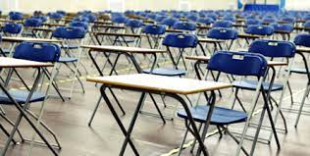
Seating
Once you have entered the exam room you are under exam conditions
  This means that you cannot communicate in any way with any other Candidate
Seat numbers will be on the inside of the Hall doors, but will also be in the dining room for you to check beforehand. Please ensure you know your number in advance.
Once seated, the invigilator will read the instructions of the exam and will announce when you can start.
Do not write anything on your paper
until you are instructed to do so.
It is considered Malpractice if you do.
Disturbing the exam room in any way could get you disqualified

Slide 11
Invigilators
Invigilators ensure that the exams are run according to the regulations
Please listen to them and follow their instructions
If you need any assistance, then please raise your hand high to alert an invigilator
  You must not shout out
  You cannot communicate with any students in the exam room
Invigilators will not answer any questions relating to the content of the exam paper

Slide 12
Malpractice
To maintain the integrity of qualifications, strict Regulations are in place
Malpractice means any action or behaviour which is in breach of the Regulations
Any alleged, suspected or actual incidents of malpractice will be investigated and reported to the relevant awarding body/bodies
The Joint Council for Qualifications (JCQ) provides information regarding what constitutes malpractice:
  Introduction of unauthorised material into the examination room
  Breaches of examination conditions
  Exchanging, obtaining, receiving, or passing on information which could be examination related (or the attempt to)
  Offences relating to the content of candidates’ work
  Undermining the integrity of examinations/assessments

Slide 13
Malpractice
You need to know that the following would be malpractice:
  copying or allowing work to be copied
    e.g. posting written work on social networking sites prior to an examination/assessment;
  collusion: allowing others to help produce your work or helping others with theirs;
  asking others about what questions your exam will include (even if no one tells you);
  having or sharing details about exam questions before the exam (whether you think these are real or fake)
  not telling exam boards or your school/college about exam information being shared.

Slide 14
Malpractice
There are severe penalties for malpractice.
You could be disqualified from your exams.
Examples of malpractice:
Possession of a mobile phone or smart enabled device - even if switched off
  >>>>> Students will be scanned before entry to ensure that they are not carrying any prohibited devices
  into exam rooms.
Writing/drawing obscene material
Talking/disrupting others
Possession of notes
Writing on hands/skins
Possession of a Watch
Offensive Language
Please check your pockets before you go into every exam

Slide 15
Consequences of Malpractice
If you are caught or suspected of committing malpractice, then an investigation will take place. We are obliged to report it to the Exam Boards and they will make the decision on sanctions.
Written warning
Loss of marks for that paper
Loss of marks for that subject
Loss of marks for all exams with the that exam board
All exams cancelled for all exam boards
Banned from taking exams for 1-5 years
In 2024 2,145 students had their papers zeroed due to malpractice.
41.4% of all malpractice cases were due to mobile phones

Slide 16
Unauthorised Items
The following are not allowed in the exam room:
Mobile phones, other smart enabled devices, watches
Non-transparent water bottles/pencil cases
Gel Pens
Tippex
Earphones/plugs
Food
Writing on hands/skin
Labels on water bottles
Notes of any sort - check your pockets
Watches

Slide 17
If you are ill on the day of an exam
If you are feeling unwell on the day of your exam, we suggest you come into school and we can assess the situation when you arrive.
In most cases, it is better to take the exam if you can.
You CANNOT sit the exam at another time.
If you are ill and unable to attend the exam, it is vital you phone the school first thing in the morning.
If you are absent from an exam due to illness, you may be required to complete a Self Declaration Form which will be submitted to the Exam Board.
If you do not attend an exam without a valid reason you may forfeit your chance of a grade in that subject and it is possible that you will be charged the entry fee for the exam.
If in doubt – phone the school.

Slide 18
If I’m late, can I still sit the exam?
If you think you are going to be late for the start of your exam, please contact the school to inform us.
On arrival at school, a member of staff will escort you to the exam room.
You MUST NOT enter the exam room without permission once an exam has started.
Depending on how late you are, the Exam Boards may not accept your script.

Slide 19

Helpful Tips
Listen and follow instructions.
Check that you have the correct paper and write your full legal name in the correct sections on the front of the exam paper.
Write only when instructed.
Read the exam paper thoroughly – to the back page.
Raise your hand (high up) for assistance.
Think - do not rush your answers.
Neatly cross out any incorrect work, but no doodling.
Use all available time wisely.
Remain silent at all times.

Slide 20
Additional Advice
Go to the toilet before your exam
If you have been allocated Rest Breaks you must raise your hand to request to take these
  Your time will be paused and restarted when you begin your exam again.
Fire Evacuation Procedure
  In the event of a fire alarm, please follow the guidance of the Invigilators
  You are still under exam conditions so REMAIN IN SILENCE

Slide 21


